Slide 1
Critical thinking and the justice system
Easton White
Alan Hastings
Winter 2018

Slide 2
Learning objectives
By the end of today:
Understand common tools used in the courtroom
Understand and apply basic ideas from probability theory

Slide 3
Evidence in the courtroom

Slide 4
Evidence in the courtroom
Fingerprinting
DNA evidence
Eye witness testimony
Video and audio
Witness testimony
Other physical evidence

Slide 5
Evidence in the courtroom
Fingerprinting
DNA evidence
Eye witness testimony
Video and audio
Witness testimony
Other physical evidence

Slide 6


Slide 7
What do you remember from the scene?
How many people were involved in the crime (including the victim)?
What were the robbers wearing?
What language were they speaking?
What else do you remember?

Slide 8
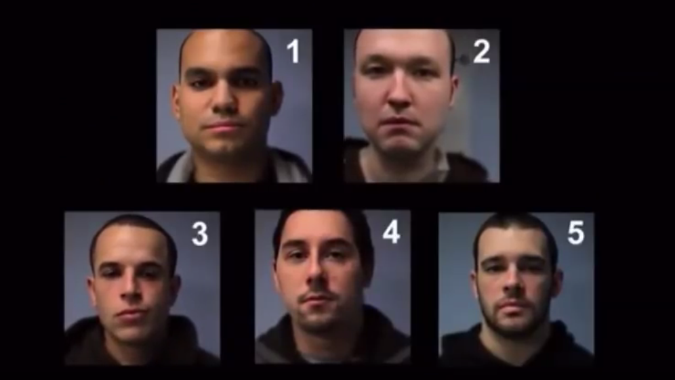
Who committed the robbery?
Notes:
https://www.youtube.com/watch?v=RWO2UQ4MW7U

Slide 9
Which of these statements are false?
The woman’s coat is red
The man dropped his camera
The camera is silver
The victim was wearing a backpack

Slide 10
Conclusions
Eye witness testimony is not always reliable. A number of factors may affect one’s memory.

Slide 11
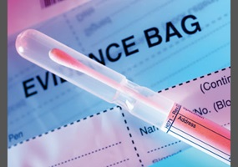
DNA evidence
DNA evidence can be mishandled like any other piece of evidence
Often will get no match, or only close matches
It depends on what data you are comparing the DNA evidence against
Notes:
http://www.slate.com/articles/technology/technology/2013/06/dna_math_if_police_find_a_genetic_match_that_doesn_t_mean_they_have_the.html

Slide 12
DNA evidence
Suppose you get DNA from a hair found at the scene of the crime and find six usable places in the genome to test. The chance that any given person is a genetic match at those six places is pretty small, say 1 in 5 million.
If someone matches at those six places, are they likely the perpetrator?
Notes:
http://www.slate.com/articles/technology/technology/2013/06/dna_math_if_police_find_a_genetic_match_that_doesn_t_mean_they_have_the.html

Slide 13
A similar example to the DNA case

Slide 14
Sudden Infant Death Syndrome
Notes:
https://www.mayoclinic.org/diseases-conditions/sudden-infant-death-syndrome/symptoms-causes/syc-20352800

Slide 15
Sudden Infant Death Syndrome
Sally Clark, a British woman, was accused of killing her two children who died at 11 and 8 weeks of age
Sudden infant death syndrome occurs in about 1/8543 or 0.011% of children
Notes:
http://bayesian-intelligence.com/bwb/2012-03/sally-clark-is-wrongly-convicted-of-murdering-her-children/
http://www.slate.com/articles/technology/technology/2013/06/dna_math_if_police_find_a_genetic_match_that_doesn_t_mean_they_have_the.html

Slide 16
Sudden Infant Death Syndrome
Sally Clark, a British woman, was accused of killing her two children who died at 11 and 8 weeks of age
Sudden infant death syndrome occurs in about 1/8543 or 0.011% of children
In the court case, an “expert witness” argued that the chance of two cases of SIDS in one family was then (1/8543)*(1/8543) = 1 in 73 million
Prosecutor argued that the chance Sally Clark was innocent was 1 in 73 million
Notes:
http://bayesian-intelligence.com/bwb/2012-03/sally-clark-is-wrongly-convicted-of-murdering-her-children/
http://www.slate.com/articles/technology/technology/2013/06/dna_math_if_police_find_a_genetic_match_that_doesn_t_mean_they_have_the.html

Slide 17
Sudden Infant Death Syndrome
We want to know is Sally Clark innocent or guilty?

Slide 18
Two main problems with argument
Assumption of independence and probability of two cases of SIDS
Further, the calculation is not a measure of guilt or innocence

Slide 19
Calculating the probability of SIDS
The number 1 in 73 million turns out to be too high
Does not account for fact that boys are more likely to die of SIDS
Does not account for fact that those with one SIDS case are more likely to have another
It turns out a better estimate is something like 1 in 1,000,000

Slide 20
Interpretation of calculations in incorrect
1 in 1,000,000 is the probability of deaths given she is not guilty, it is not the probability she is guilty given two deaths
We want to know what is the probability she is guilty given two deaths
We need to “condition” our calculations on whether or not she is guilty

Slide 21
To the white-board

Slide 22
Conclusions
Need to be critical of how reliable various pieces of evidence are
More lines of evidence is better than a single source
Need to be careful with interpretations of statistics, even from “experts”
This is particularly true with big and small numbers

Slide 23
Homework for next week
Work on Breast cancer problem

